Slide 1

Intelligent Restaurant Operations Platform with Real-Time Performance Analytics

Slide 2

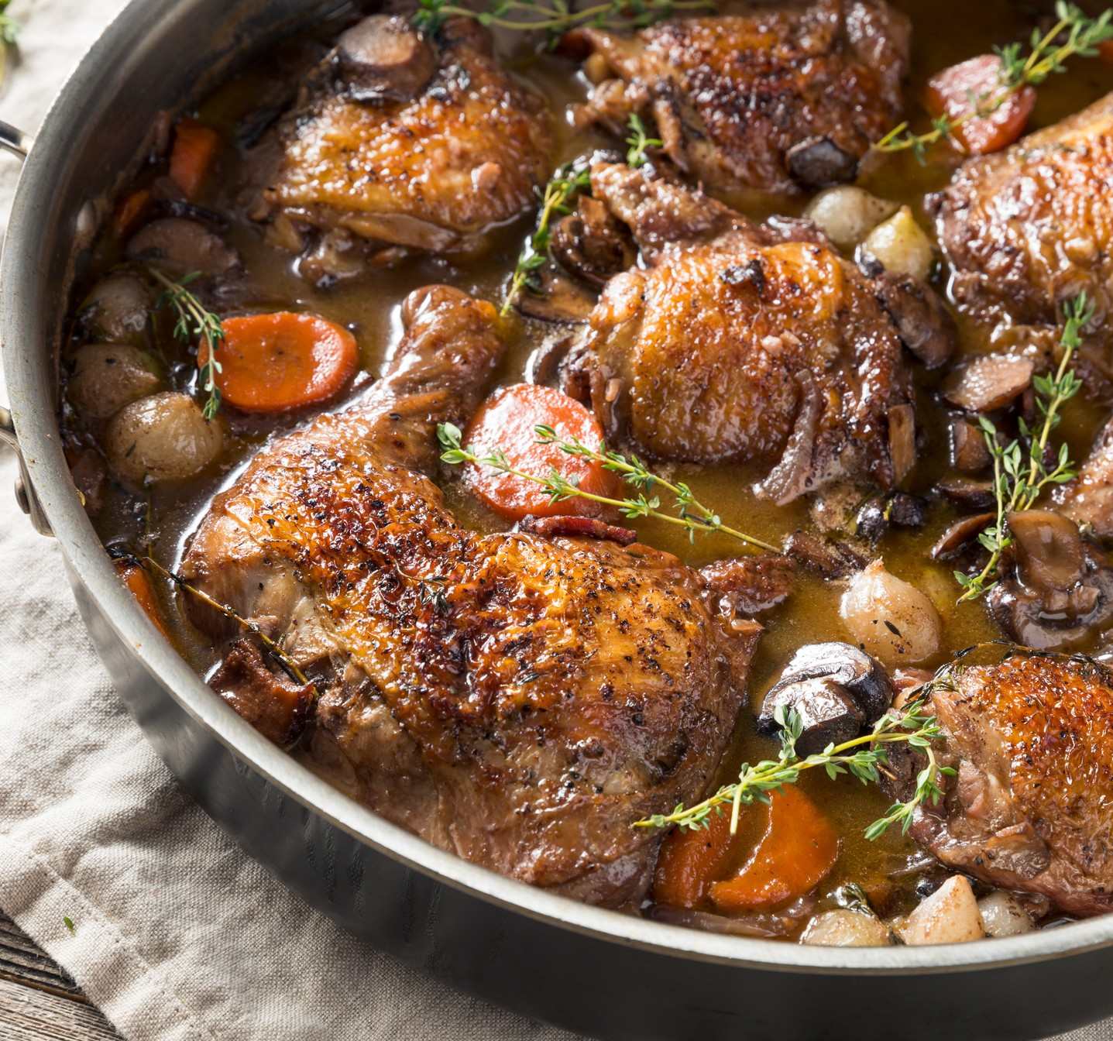

Table Of Content
Introduction.
Modules. Conclusion.

Slide 3
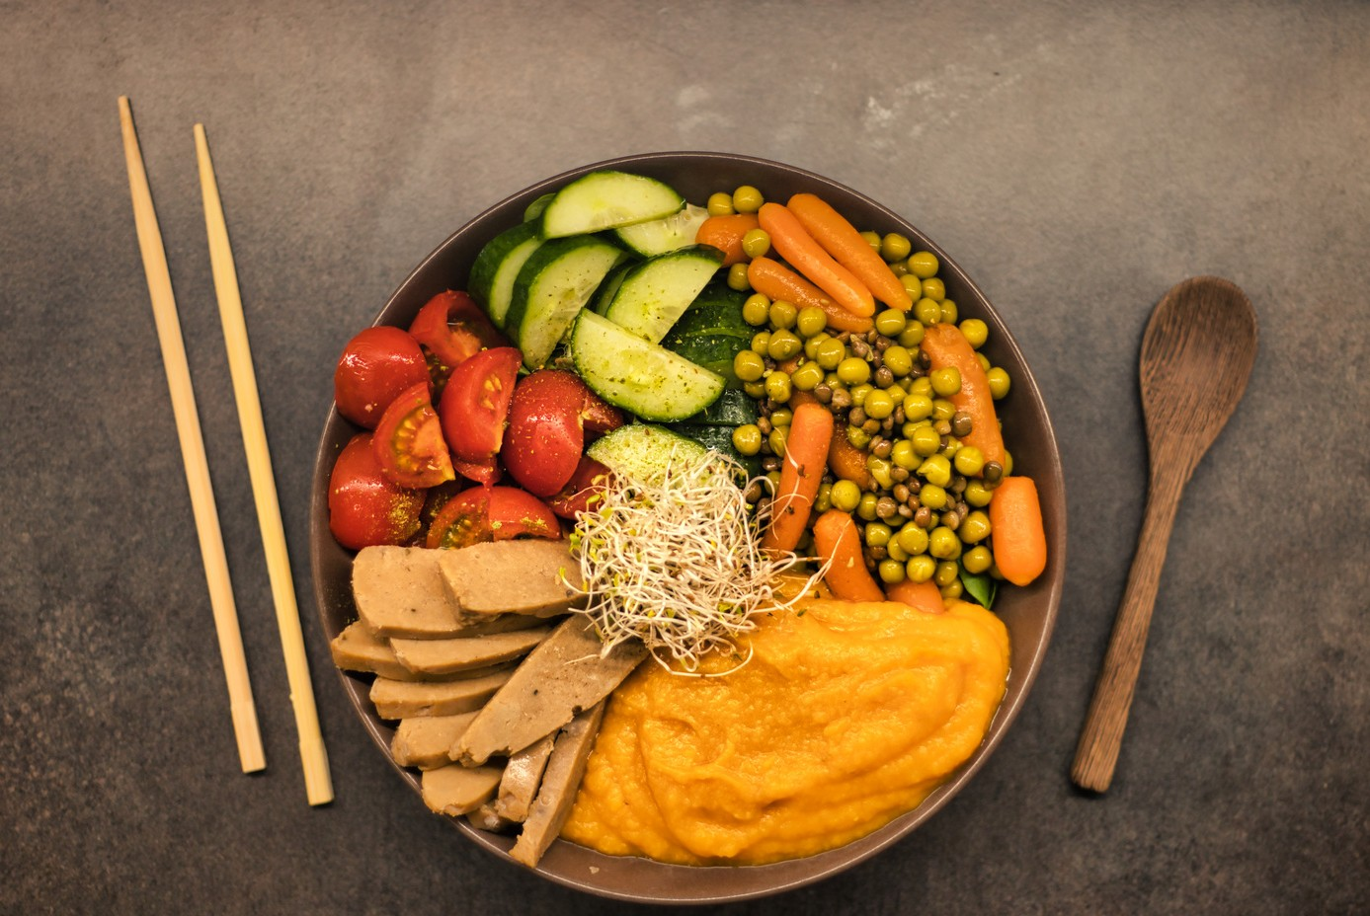


Introduction :
A restaurant management system is a software application that helps restaurant owners and managers streamline their day-to-day operations, from taking orders to managing inventory and staff. The system can provide a variety of features such as menu management, order management and reporting.

Slide 4



Detail :
Menu management: Ability to manage menus, add new menu items, edit or delete existing items, categorize items, and set prices.
Order management: Ability to create and manage orders, track their status, assign them to tables, and modify them as needed.
Customer management: Ability to track customer information, preferences, and feedback, and use that information to improve the customer experience.
Payment processing: Ability to calculate and process customer payments, accept multiple forms of payment, and generate invoices and receipts.

Slide 5

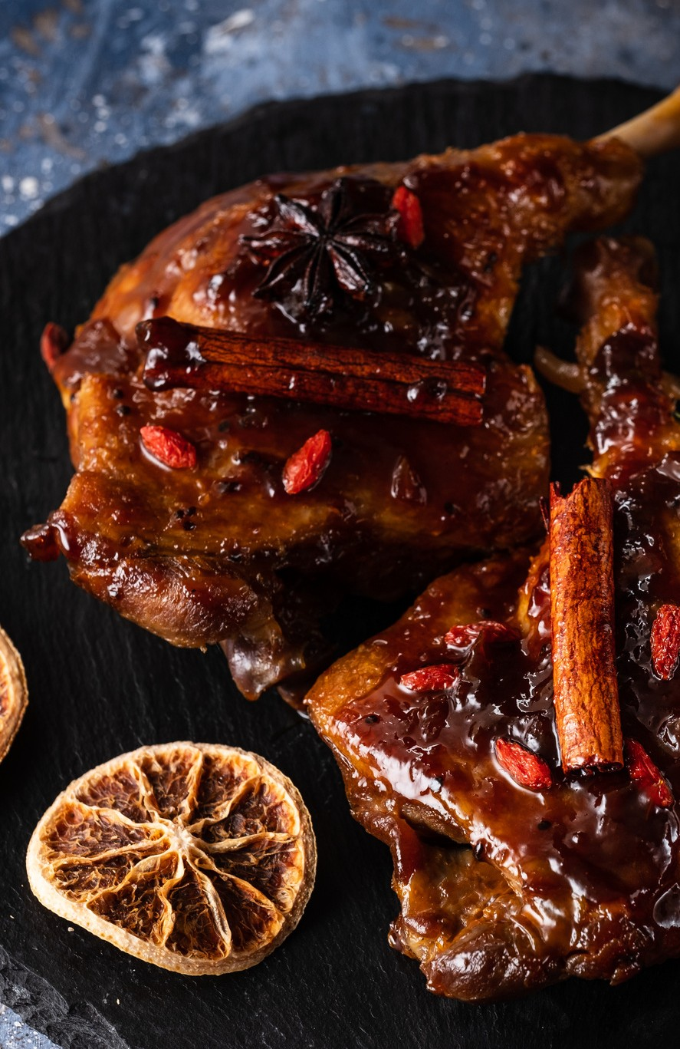
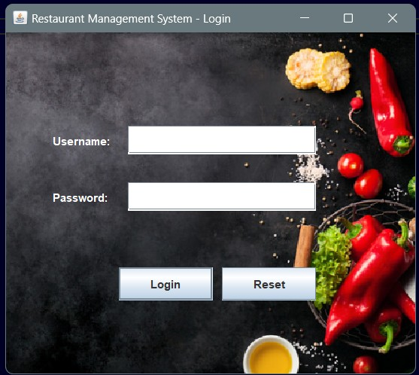
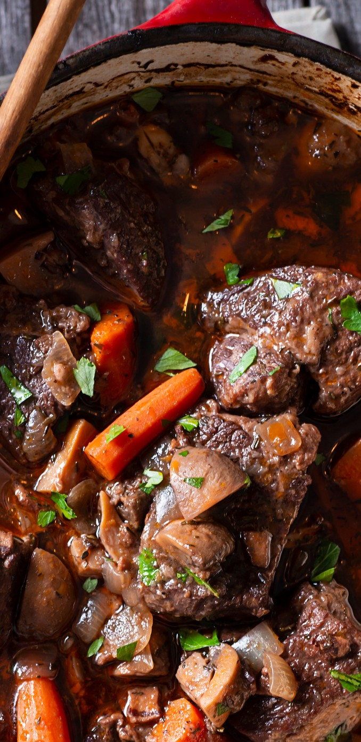
login Module :
Modules:
The Login page is an essential security feature for any system that requires user authentication, as it prevents unauthorized access by requiring users to provide valid login credentials. Once the user enters their credentials, the system can verify their identity and grant them access to the protected resources.

Slide 6
Modules:
Menu Module :
The Menu page is an essential feature of a restaurant management system, as it provides a centralized interface for staff to manage all aspects of restaurant operations. The page is designed to be intuitive and easy to navigate, with clear and organized menus and buttons that allow staff to quickly find and perform the tasks they need.

Slide 7

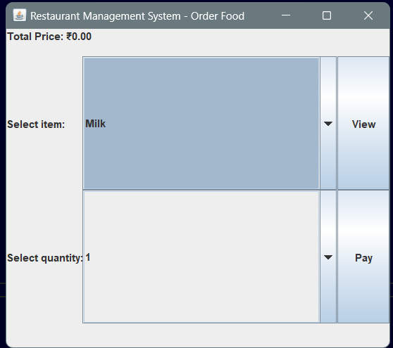
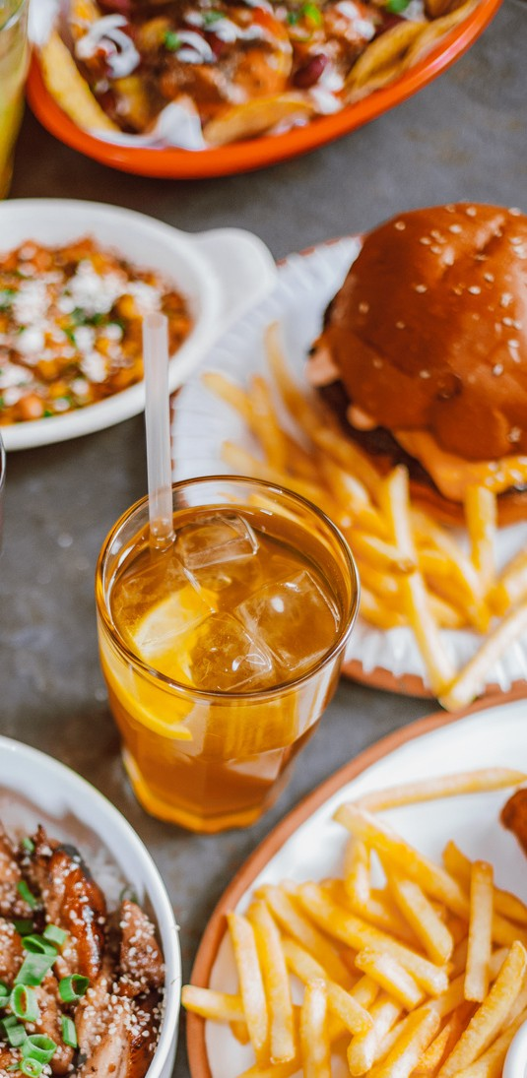
Order Module:
Modules:
The order module with menu list items, prices, and payment button will be designed to be customizable and flexible. The system will allow restaurant staff to easily update the menu list with new items, prices, and categories as needed. The payment button will also be customizable to integrate with different payment processing systems.

Slide 8


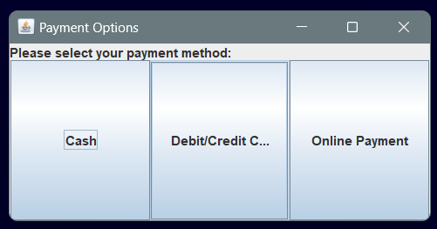
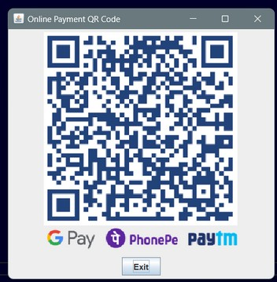
Modules:
Payment Module :
The payment module will also include additional features, such as tips and split payments. Customers will be able to add tips to their payment, and staff members will be able to split payments between multiple customers or cards if needed.
The payment module will be designed to be customizable and flexible, allowing restaurant staff to configure different payment options and settings as needed. The system will also be able to generate detailed reports on payment transactions, including sales totals, payment types.

Slide 9

The restaurant management system in Java provides an effective way to streamline various restaurant management tasks, making it easier for staff to manage operations efficiently. The system's flexibility, scalability, user-friendliness, and data management capabilities make it an ideal solution for any restaurant looking to improve its operations.
Conclusion

Slide 10



